Slide 1
A Space Odyssey
Amandeep Singh

Slide 2
Aim:
To explore and analyse interplanetary trajectories.
To formulate a program that predicts basic trajectories and get a feel of real life interplanetary missions undertaken by space agencies such as NASA or ISRO

Slide 3

Fundamental equation of relative two body motion
$\vec{\ddot{r}}$= - $\frac{μ}{r^{3}}\vec{r}$ where µ=G($m_{1}+m_{2}$)
Orbit Equation
r = $\frac{h^{2}}{μ}\frac{1}{1+e\cos{θ}}$ where $θ$ = true anomaly
e = eccentricity
h = angular momentum

Slide 4
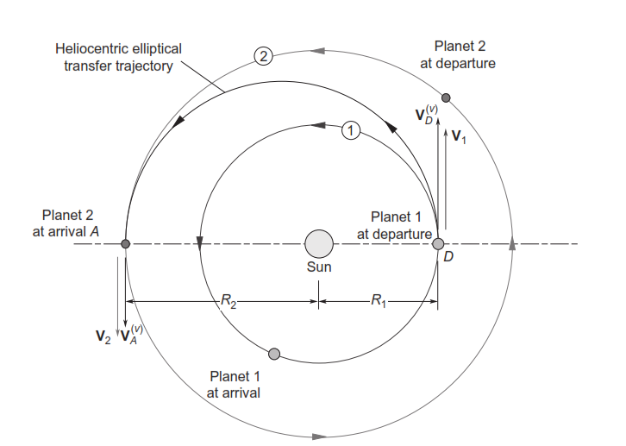

Slide 5
Basic Interplanetary Mission
Insertion into a parking orbit
delta_v at a particular location in the parking orbit
Escape Hyperbola
Crossing the sphere of influence of the home planet
Cruise Phase w.r.t. sun
Entry into the sphere of influence of target planet
Entry Hyperbola
delta_v at a particular location(usually at the perigee of the approach hyperbola)
Insertion into the Capture orbit of the target planet

Slide 6
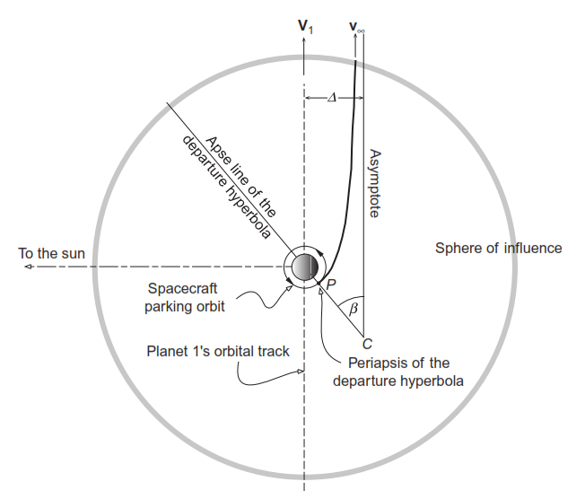

Slide 7
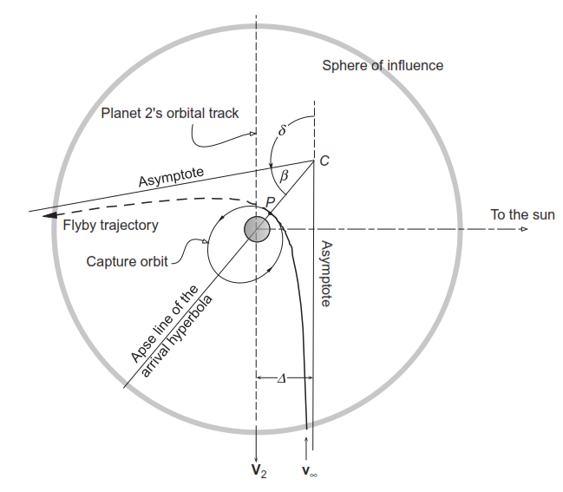

Slide 8

Sphere of Influence
A reasonable estimate of the distance beyond which the sun’s gravitational attraction dominates that of a planet.
$$r_{SOI}=R{(\frac{m_{p}}{m_{s}})}^{\frac{2}{5}}$$

Slide 9

Lagrange Coefficients
If the position and velocity of an orbiting body are known at a given instant, then the position and velocity at any later time are found in terms of the initial values.
r = f$r_{0}$ + g$v_{0}$
v = $\dot{f}r_{0}$ +$\dot{g}v_{0}$
Where f , g , $\dot{f}$, $\dot{g}$ are known as the Lagrange Coefficients

Slide 10
What do we need as input?
State vectors (Position and Velocity) of our spacecraft at any instant
What we can work with:
State Vectors of the two planets
Time taken for the mission
Problem:
DIFFICULT TO DETERMINE EXACT STATE VECTORS OF THE PLANETS

Slide 11
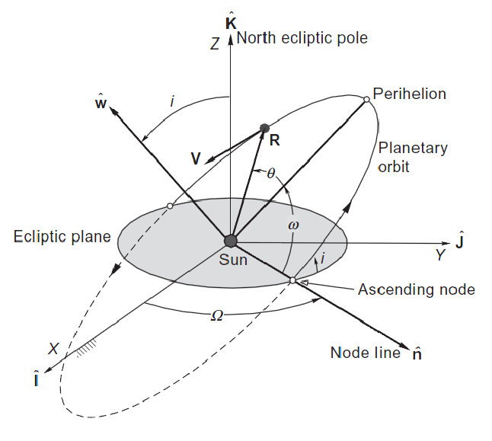

Slide 12

In astronomy and celestial navigation, an ephemeris gives the positions of naturally occurring astronomical objects as well as artificial satellites in the sky at a given time or times.
We’ll use the data given with respect to the J2000 epoch (1 January 2000, 12h UT)
Given orbital elements with their rates of change w.r.t. a century :
a , e , i ,$Ω$ , $π$($ω$+$Ω$), L($π$+M)

Slide 13
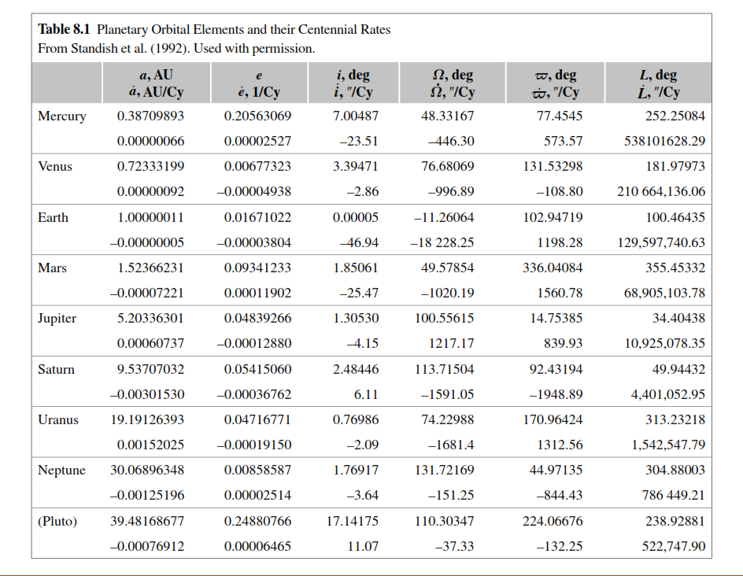

Slide 14
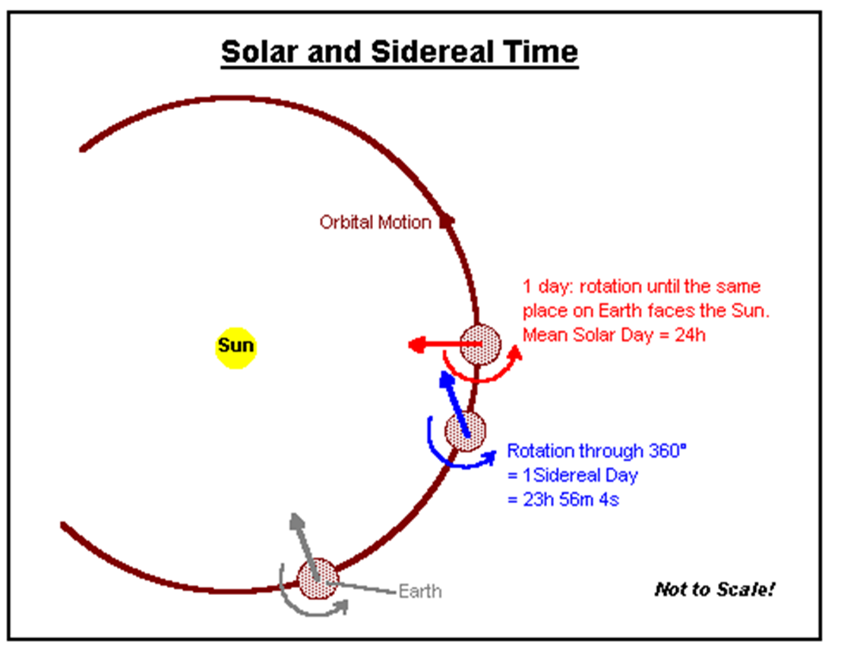
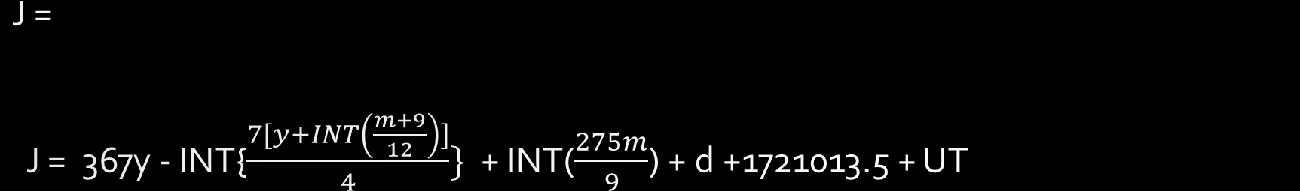
J = J = 367y - INT{$\frac{7[y+INT\left(\frac{m+9}{12}\right)]}{4}\}$+ INT($\frac{275m}{9}$) + d +1721013.5 + UT
Algorithms for determining sidereal time rely on the notion of Julian day (JD)
The Julian day number is the number of days since noon UT on January 1, 4713 BC.

Slide 15
Our basic algorithm:
Orbital Elements of the planets at entered time from the planetary ephemerides
State Vectors from the orbital elements
Deduction of the interplanetary orbit by Lambert’s Algorithm using the position vectors of the planets and the time taken
Determination of the required speed of the spacecraft at departure and arrival

Slide 16

Lambert’s Method:
$f=1−\frac{μr_{2}}{h^{2}}\left(1−\cos{∆θ}\right) g=\frac{r_{1}r_{2}}{h}\sin{∆θ}$
$\dot{\dot{f}=\frac{μ}{h}\frac{1−\cos{∆}θ}{\sin{∆θ}}\left[\frac{μ}{h^{2}}\left(1−\cos{Δθ}\right)−\frac{1}{r_{1}}−\frac{1}{r_{2}}\right] \dot{g}=1−\frac{μr_{1}}{h^{2}}}\left(1−\cos{Δθ}\right)$
$f=1−\frac{χ^{2}}{r_{1}}C\left(z\right) g=Δt−\frac{1}{\sqrt{μ}}χ^{3}S(z)$
$\dot{\dot{f}=\frac{\sqrt{μ}}{r_{1}r_{2}}χ\left[zS\left(z\right)−1\right] \dot{g}=1−\frac{χ^{2}}{r_{2}}C(z)}$

Slide 17

$A=\sin{Δθ}\sqrt{\frac{r_{1}r_{2}}{1−\cos{Δθ}}}$ $z=\frac{1}{a}$
$y\left(z\right)=r_{1}+r_{2}+A\frac{zS\left(z\right)−1}{\sqrt{C(z)}}$
$\sqrt{μ}Δt=[{\frac{y(z)}{C(z)}]}^{\frac{3}{2}}S\left(z\right)+A\sqrt{y(z)}$ to be solved iteratively for z.
Resulting expressions:
$f=1−\frac{y\left(z\right)}{r_{1}} g=A\sqrt{\frac{y(z)}{μ}}$
$\dot{f}=\frac{\sqrt{μ}}{r_{1}r_{2}}\sqrt{\frac{y(z)}{C(z)}}\left[zS\left(z\right)−1\right] \dot{g}=1−\frac{y(z)}{r_{2}}$

Slide 18

$r_{2}=fr_{1}+gv_{1}$
$v_{2}=\dot{f}r_{1}+\dot{g}v_{1}$
Condition : $f\dot{g}−\dot{f}g=1$
$v_{1}=\frac{1}{g}(r_{2}−fr_{1})$
$v_{2}=\frac{1}{g}(\dot{g}r_{2}−r_{1})$

Slide 19
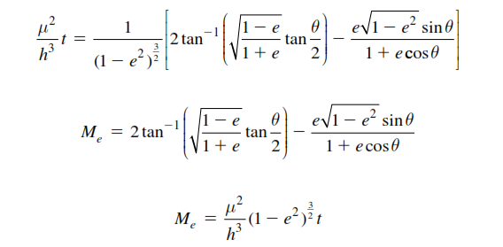

Evaluation of orbits w.r.t time
$\frac{μ^{2}}{h^{3}}\left(t−t_{p}\right)=\int_{0}^{θ}{\frac{dθ}{{(1+e\cos{θ})}^{2}}}$
For ellipse:
$\frac{2π}{T}$ = $\frac{μ^{2}{(1−e^{2})}^{\frac{3}{2}}}{h^{3}}$
Thus:
$M_{e}=nt$ where $n=\frac{2π}{T}$

Slide 20
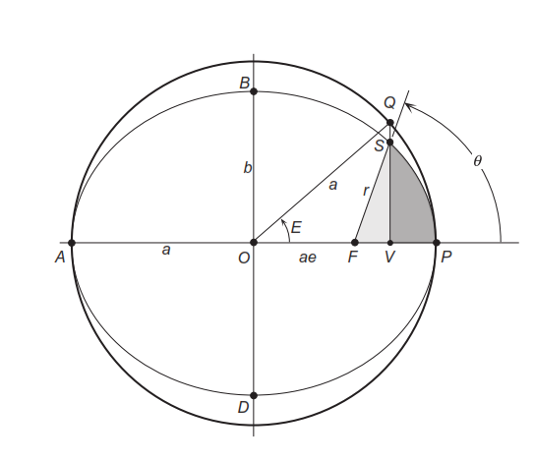

$$\tan{\frac{E}{2}}=\sqrt{\frac{1−e}{1+e}}\tan{\frac{θ}{2}}$$ Kepler’s Equation: $$M_{e}=E−e\sin{E}$$

Slide 21

Universal Variable Formulation:
$=\frac{h}{μ}\tan{\frac{θ}{2}}$ parabola
$χ=\sqrt{a}E$ ellipse
$=\sqrt{−a}F$ hyperbola
when t(since periapsis) = 0

Slide 22

Extensions to the program:
Rocket performance estimate:
$\frac{Δm}{m}$ = $1$ - $e^{− \frac{Δv}{I_{sp}g_{0}}}$
Determination of large scale Interplanetary Orbit path

Slide 23
References:
Orbital Mechanics - Howard Curtis(2010)
Fundamentals of Astrodynamics – Bate Mueller and White(1971)
Wikipedia.org
www.jpl.nasa.gov
A primer on scientific programming with python – Hans Petter Langtangen(2014)

